Slide 1

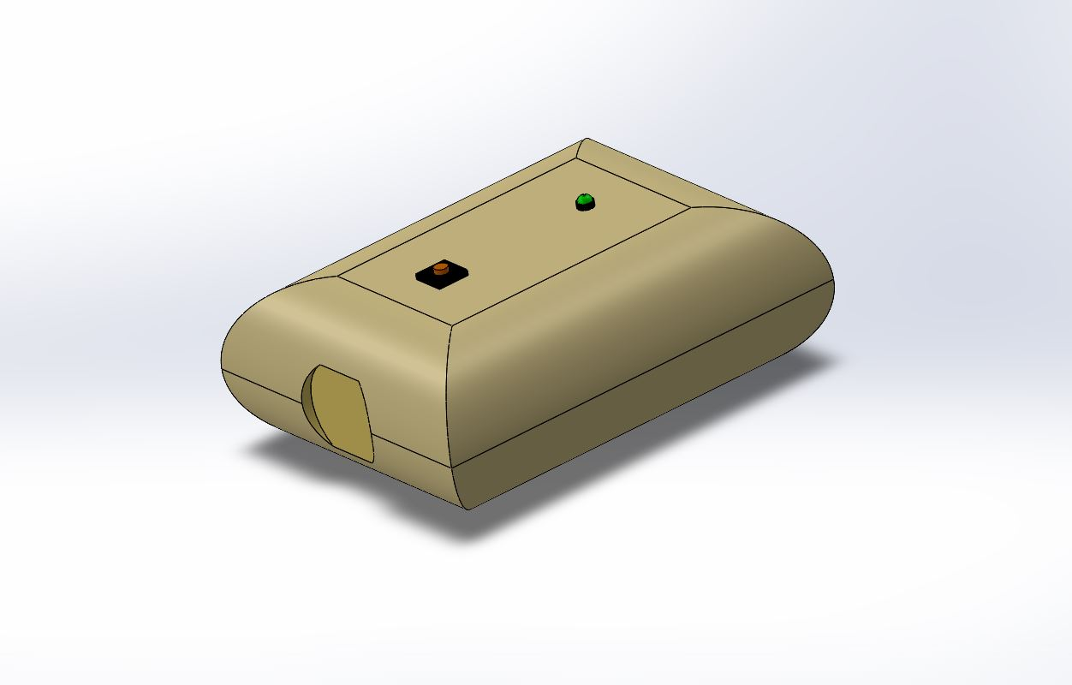
Belly Fat Reader
Department of Electronic Engineering
Interactive Systems Engineering 2 (SS2022)
Semester task: Medical device for monitoring patients
Date: 07th of June 2022
Lochana Abhayawardana

Slide 2
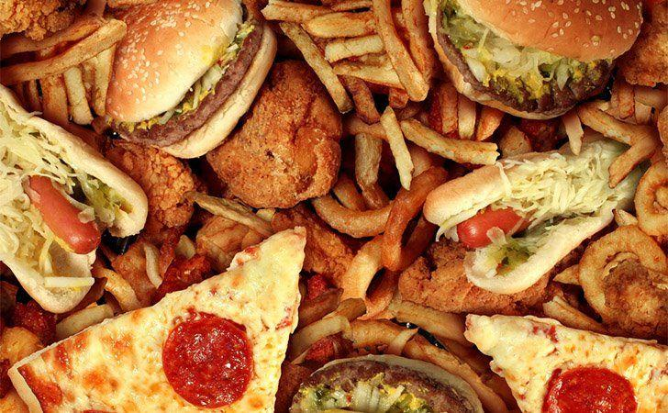
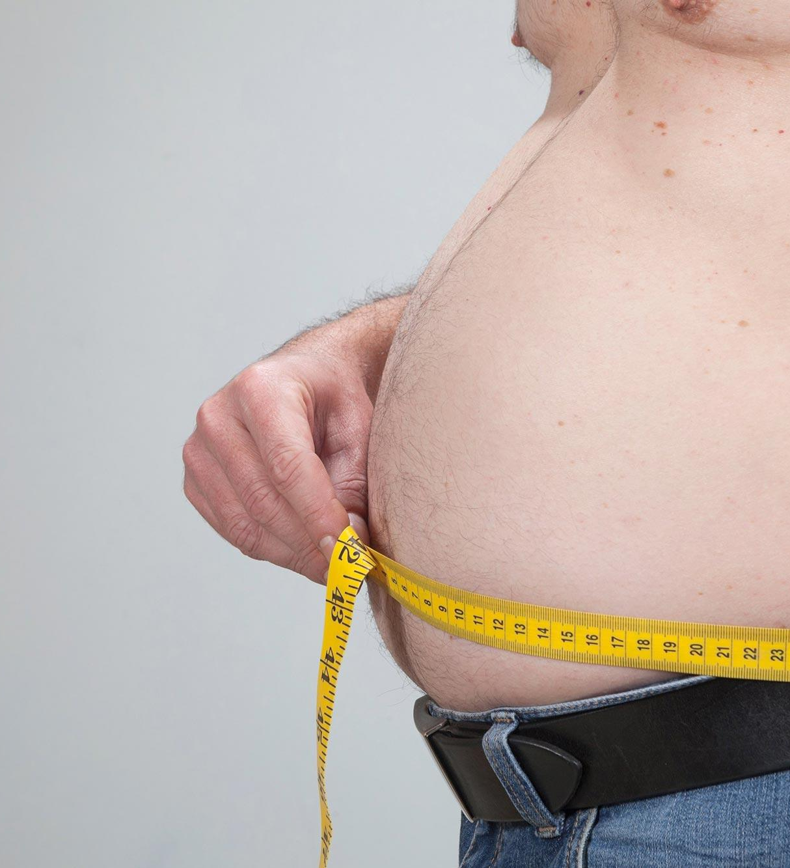
Overview
Reasons for human Belly-fat
Because of the busy lifestyle people are tend to eat lot of unhealthy foods such as fast foods and foods including too much fat,sugar and calories.
Too much alcohol, smoking
Stress and poor sleep
Lack of physical exercises
In order to maintain a healthy lifestyle we should know how many fat has gathered in your belly.
Therefore we came to an idea of designing a device to measure fat levels in human belly area.
Targeted group: People who wish to regularly monitor their belly fat level.
Fig: 2 Fast foods
Fig: 3 A person with high obesity

Slide 3
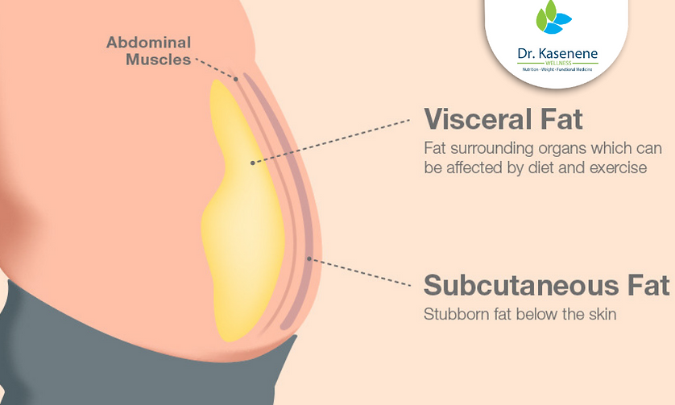
Understanding the problems
Subcutaneous fat : healthy fat
Visceral Fat : unhealthy fat
We have to figure out a way to measure visceral fat level.
Fig: 4: Kind of fat in human belly

Slide 4
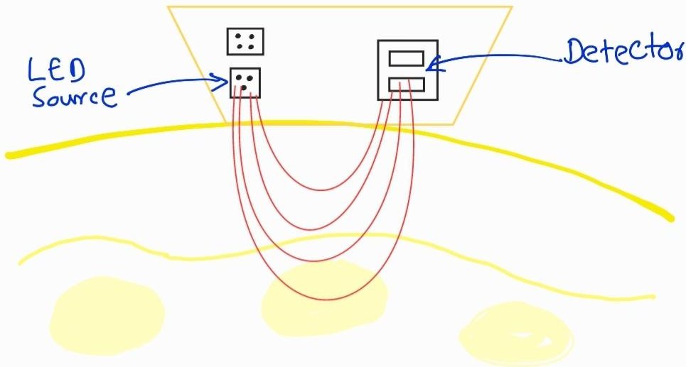
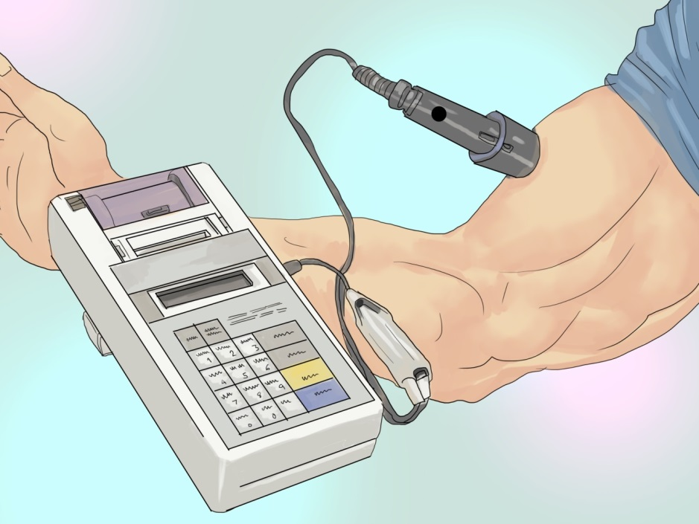
What is Near InfraRed (NIR) technology
Fig: 5: how to recognize belly fat using NIR sensor
Near-Infrared (NIR) refers to electromagnetic wavelengths that range from about 780 to 2500 nm. Belly Fat Reader uses NIR measurements to determine a person's health status by measuring tissue chromophores. A spectral range of approximately 650 to 1100 nm is used for our real-time tissue measurements. Utilizing 8-wavelength NIR LEDs (Light Emitting Diodes), we can measure tissue absorption and scattering to calculate oxyhaemoglobin, deoxyhemoglobin, water, and lipid. [1]
Fig 6: Near Infrared Interactance
Notes:
The near infrared interactance (NIR) method of assessing body composition is based on the principles of light absorption reflectance, and near infrared spectroscopy.
More specifically it is based on the ability of fat tissues to "absorb" more infrared light than lean tissue which can then be measured as a change in the infrared level.
At approximately 928 nanometers, a direct measure of how much fat exists is provided by the absorption of the infrared portion of the spectrum.

Slide 5
Health Issues
If someone wants to measure belly fat level,
Skinfold calipers
cheap,
but user requires basic anatomy Knowledge,
skin needed to be fold
Dual Energy X-ray Absorptiometry (DXA) or Air Displacement or Bioimpedance Spectroscopy (BIS)
Accuracy is high but, highly expensive,
can not use it in daily basis,
chance to exposure radiation
shorter wavelengths and Higher Energy [2]
Could harm your body!
But, We use NIR technology,
longer wavelengths and weak energy than UV
Very short time for taking measurements: the BFR device need only 3 seconds to get the measurements. (latency , L=3s)

Slide 6
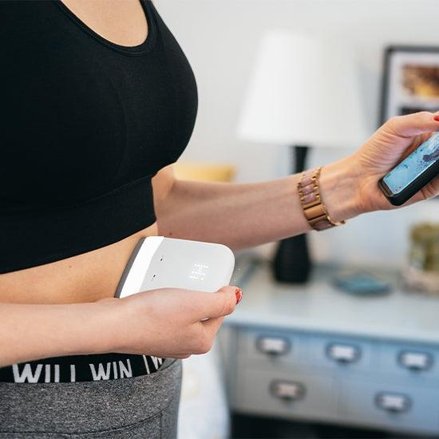
About the device - Belly Fat Reader
About the device:
compact device (size: 80*60*30)
Anyone can use it
Cheaper
One button and One LED light
Long-lasting battery power
Uses NIR technology - no healthy/radiation problems
Encrypted user and measurement data
The app can analyse, track and record the measurements and display in userfienly way.
Ability to get direct medical assistance
What is included: BFR device, BFR app (For the patients-users ), BFR app (For the doctors/ fitness trainers)
Fig: 7: How to measure your belly fat

Slide 7
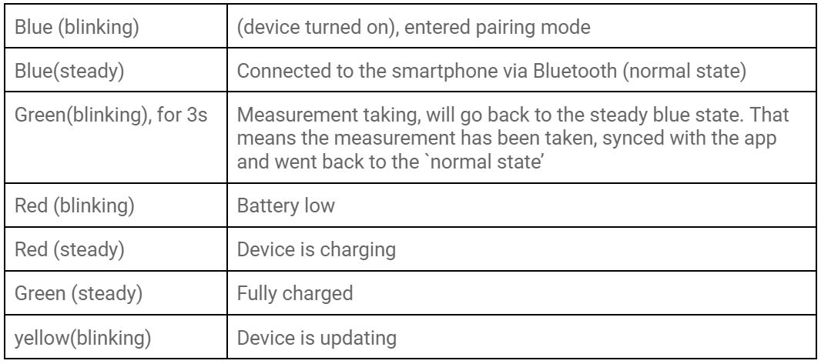
How to interact with the device
Push button : 1) press and hold: turn on
2) press once: get measurements
3) press and hold again: turn off (or turn off automatically after 3 mins after sending measurement data to app)
LED configuration
Fig: 8 the device
Fig: 9: LED configuration

Slide 8
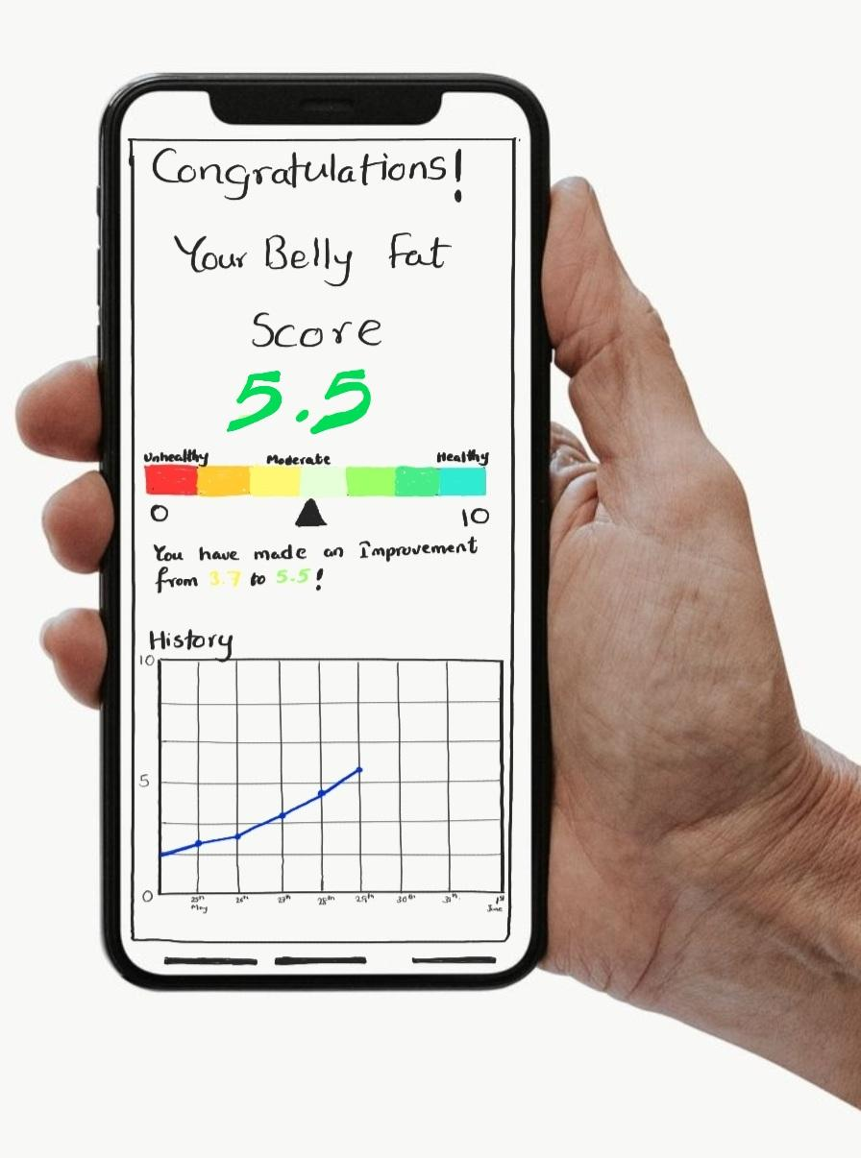
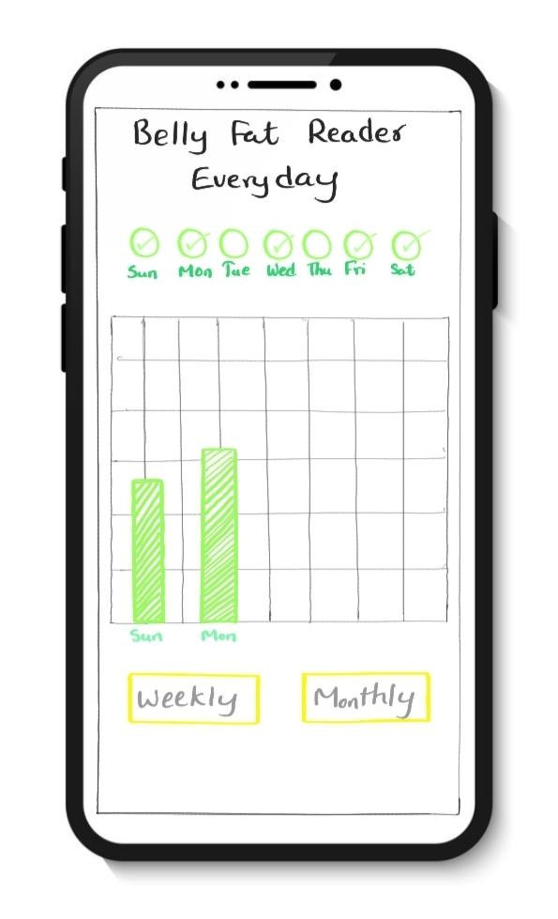
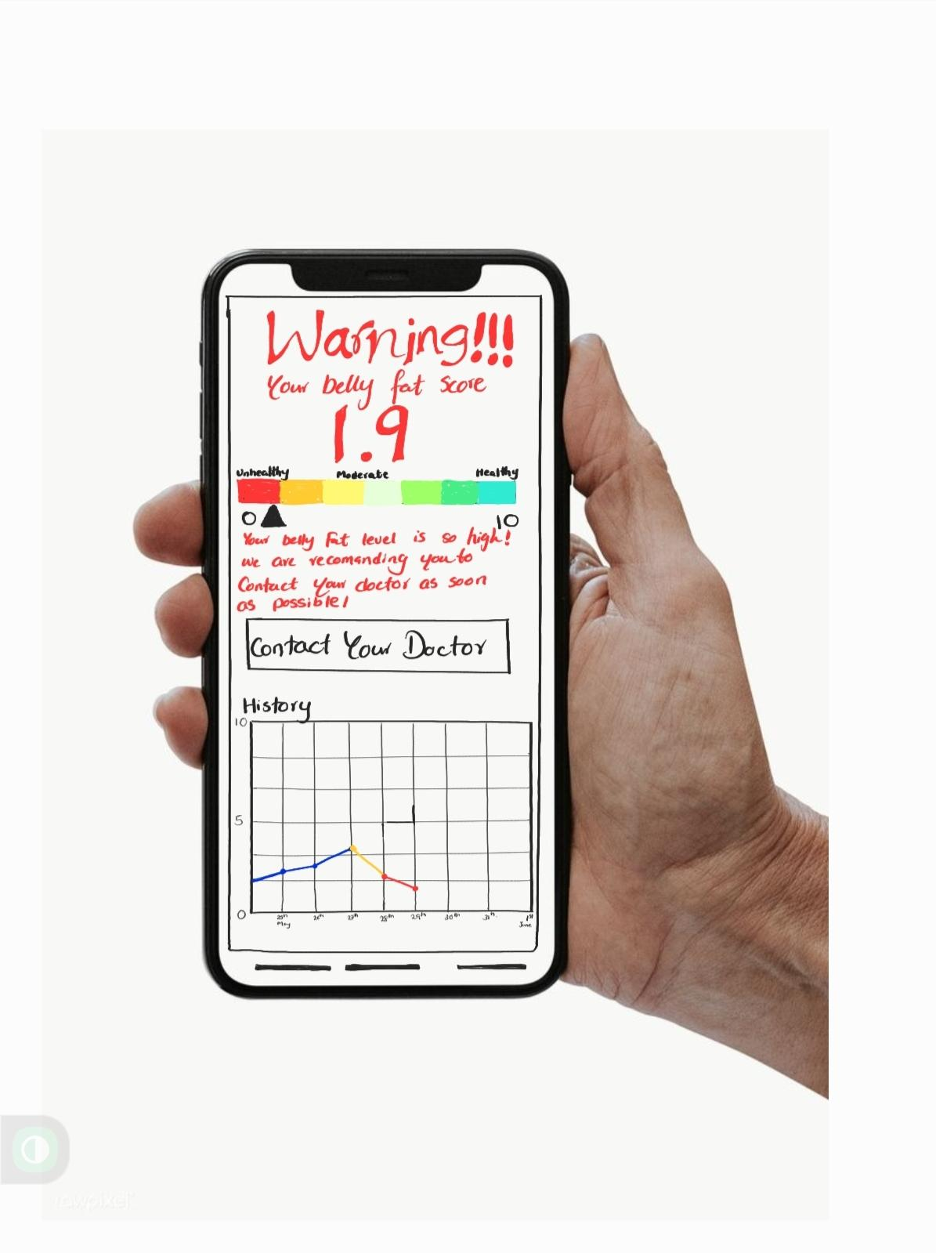
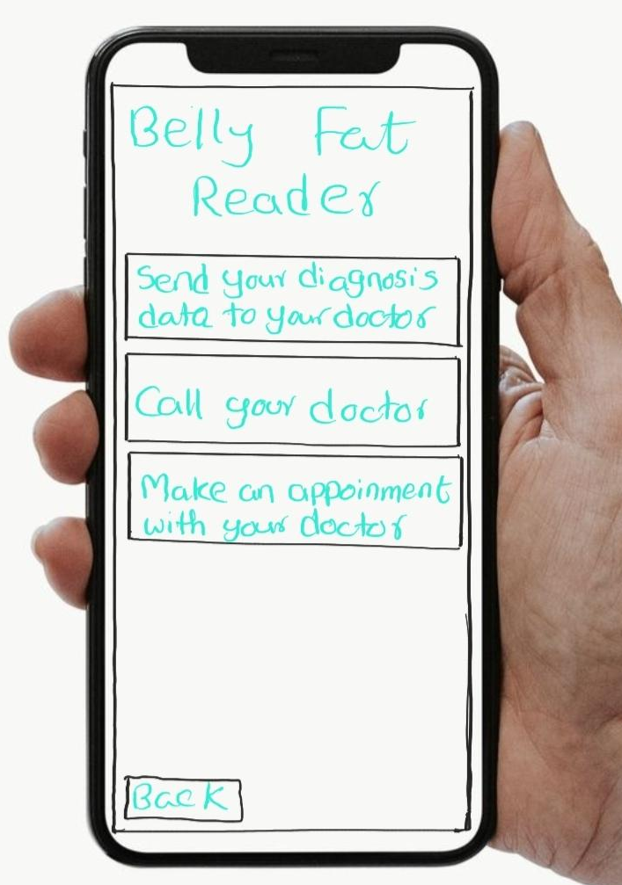
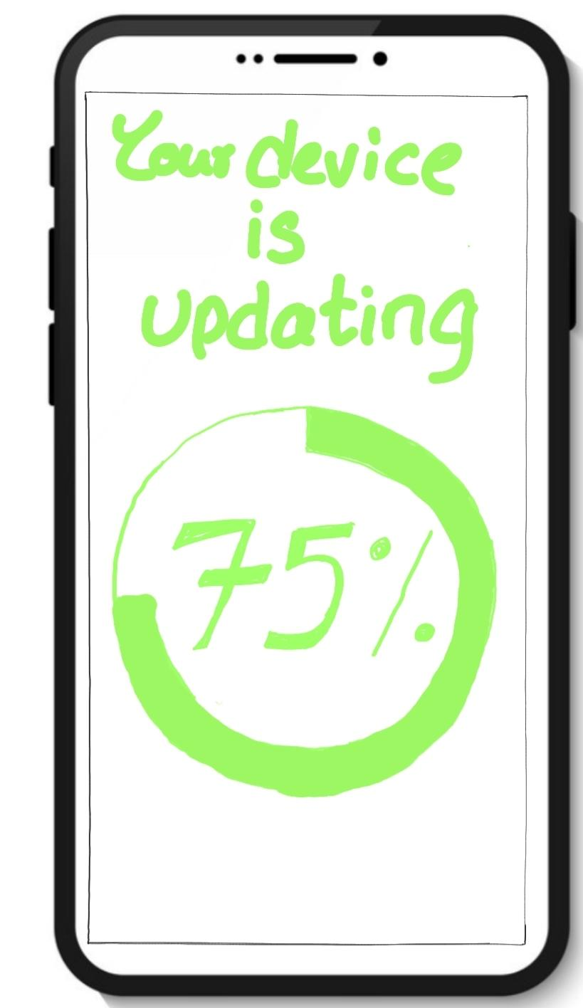
The app and user interface
App For the users
After taking measurements from the device everything else is happening from the app. You can see your,
Belly fat level
Daily / weekly/ monthly progress
Fat level forecast (based on your history) (Pro version)
Doctor’s medical assistance (Pro version)
24/7 Technical support
Updatable
Fig: 10 to 14: user interfaces

Slide 9
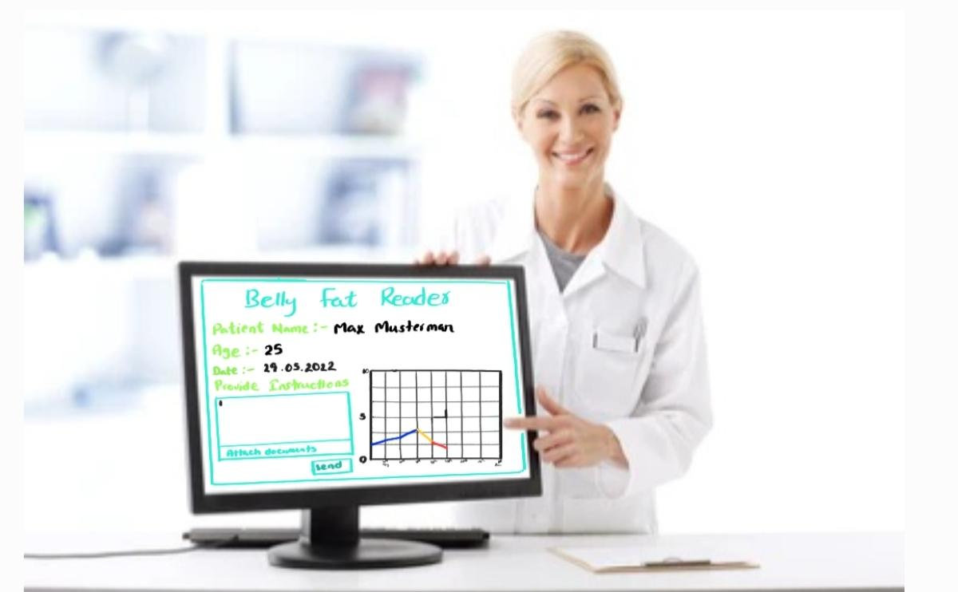
The app and user interface
App For the doctors/ Sport Trainers,
The registered doctors can log in to the BFR doctor's profile (either with smartphone app or the web version) and can review their patient's history and reports sent by the BFT apps. They can provide medical assistance if required.
Our basic Business model
The device itself cost 100€
Basic version (app): comes free with the device
Pro version (app): users can buy in order to gain BFT readers' full potential.
A yearly subscription of 50€: Doctors' medical assistance, belly fat forecast, free device repair, etc...
Registered doctors/ fitness trainers can earn money through medical assistance to the patients.
Fig: 15: the user interface for doctor

Slide 10
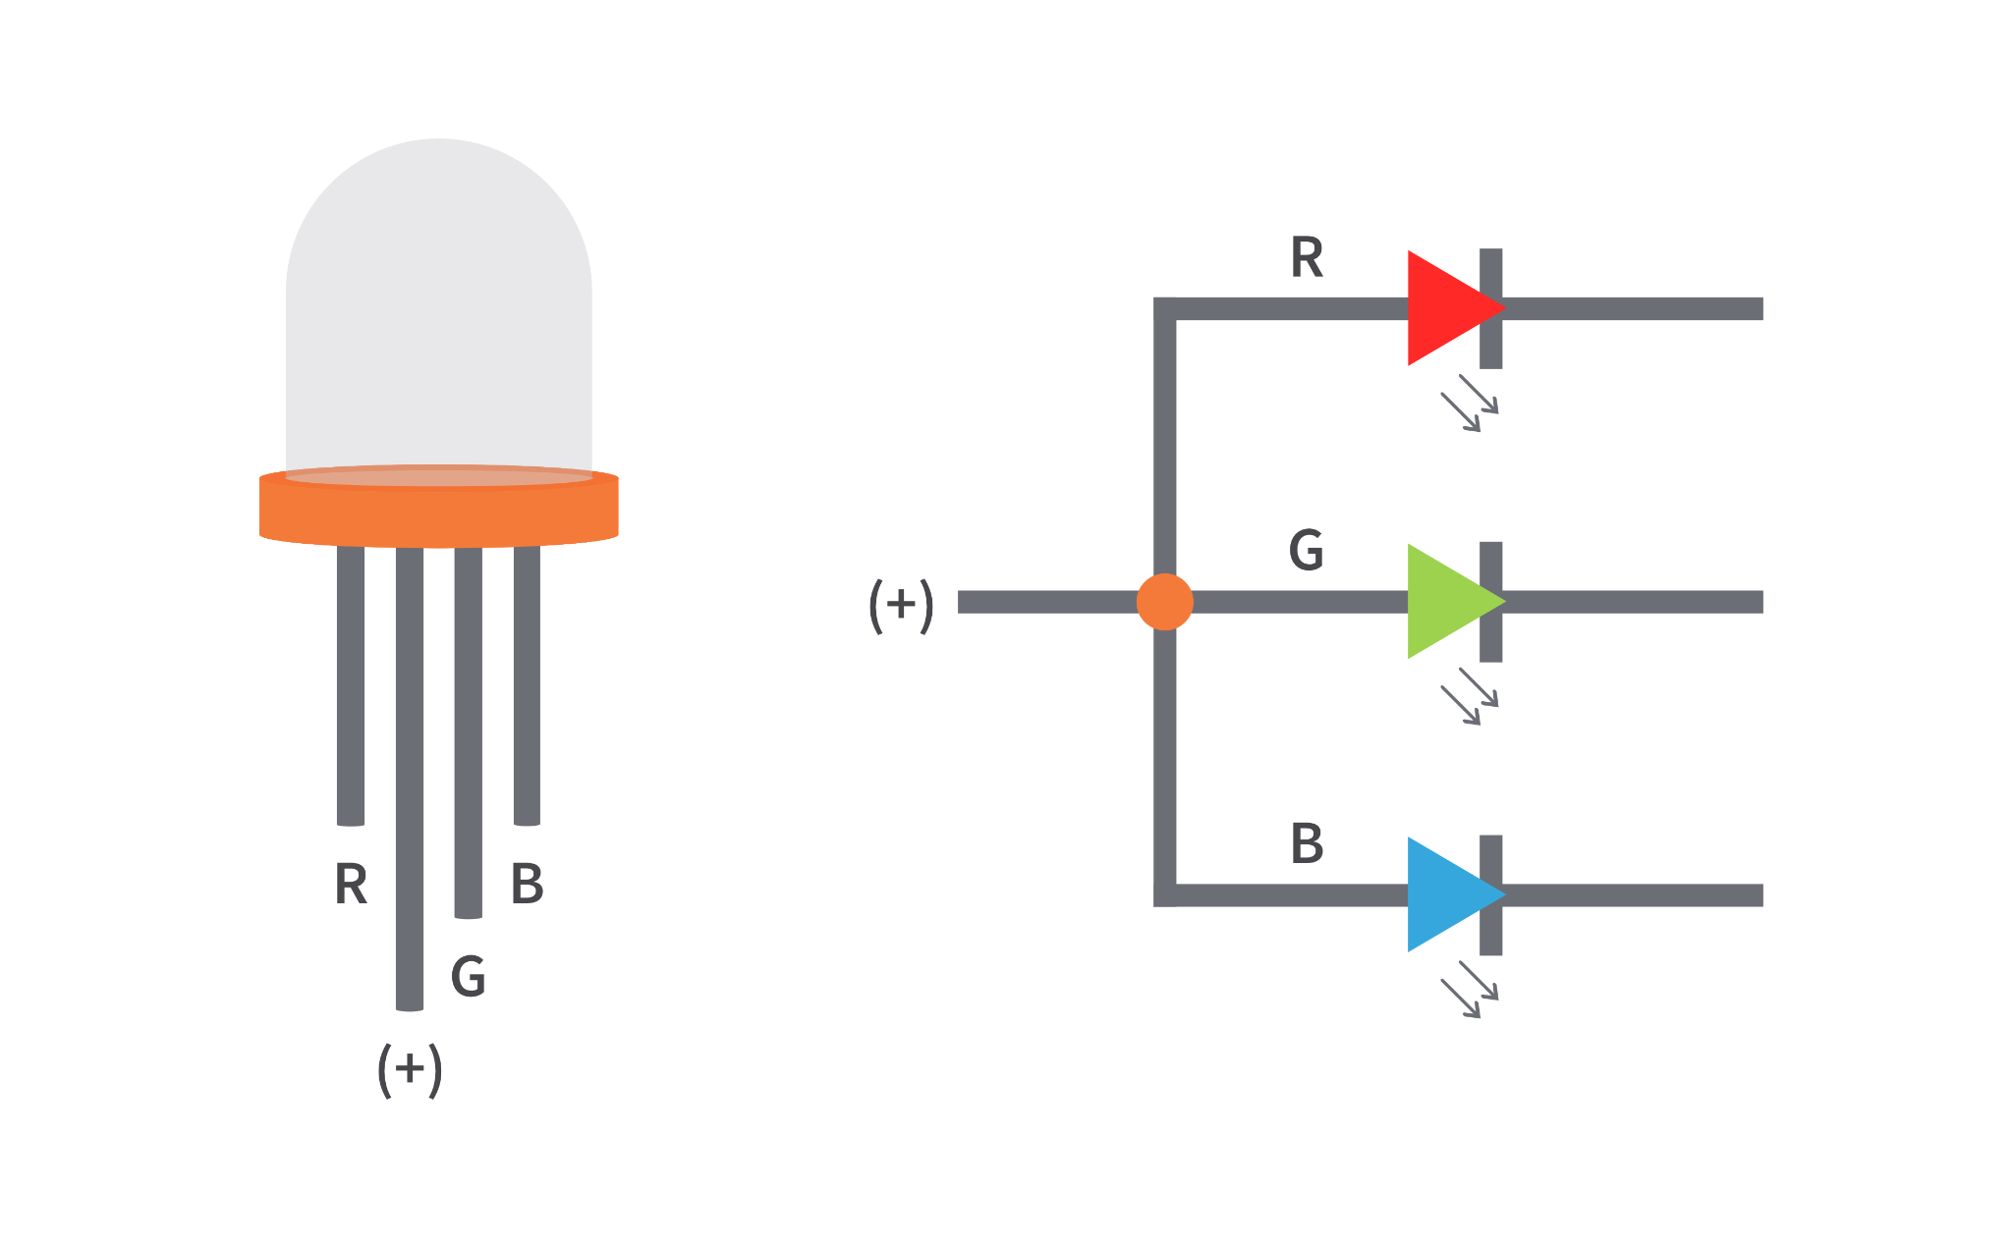
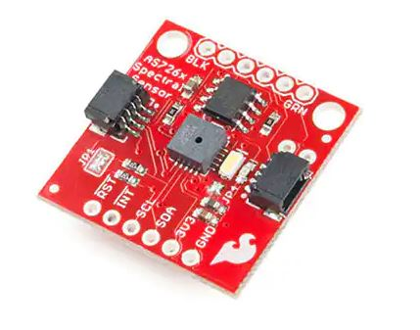
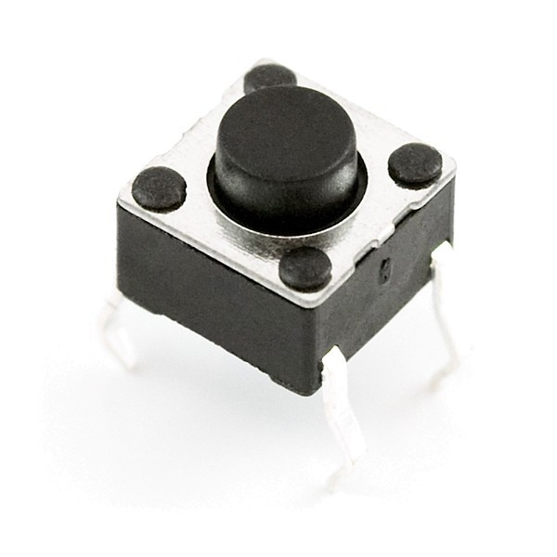
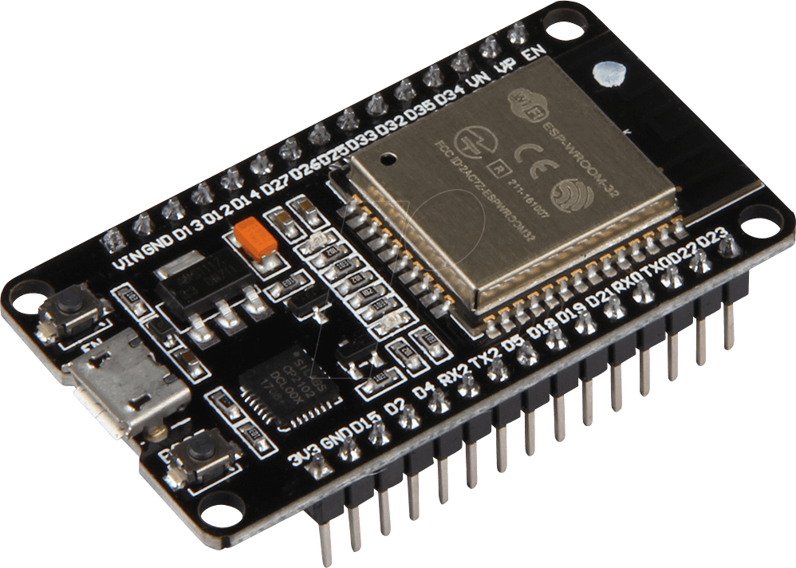
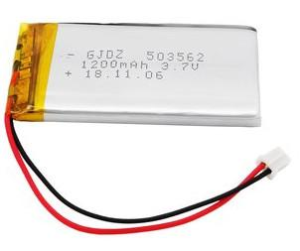
Hardware specification
4) RGB LED: low cost, one RGB LED is enough to indicate everything
5) Push button: cheap, needed for switch on, take measurement, switch off.
Fig 19: RGB LED
01) NIR sensor: Qwiic AS726X; Low cost, only need two pins to implement,Low gate count, to identify belly fat level
02) Microcontroller: ESP32 ; cheap, Built in Bluetooth modular, to control everything
3) Battery: LiPo; 1200mAh,3.7V, cheap,No need for a voltage regulator,micro USB charger, power source
Fig 16: NIR sensor
Fig 20: Push Button
Fig 17: microcontroller
Redundancy: Hot-standby redundancy
Both of the sensors are in active, If one fails other sensor can take the measurements.
Low probability of sensor failing
Save time of the user
Fig 18: Battery

Slide 11
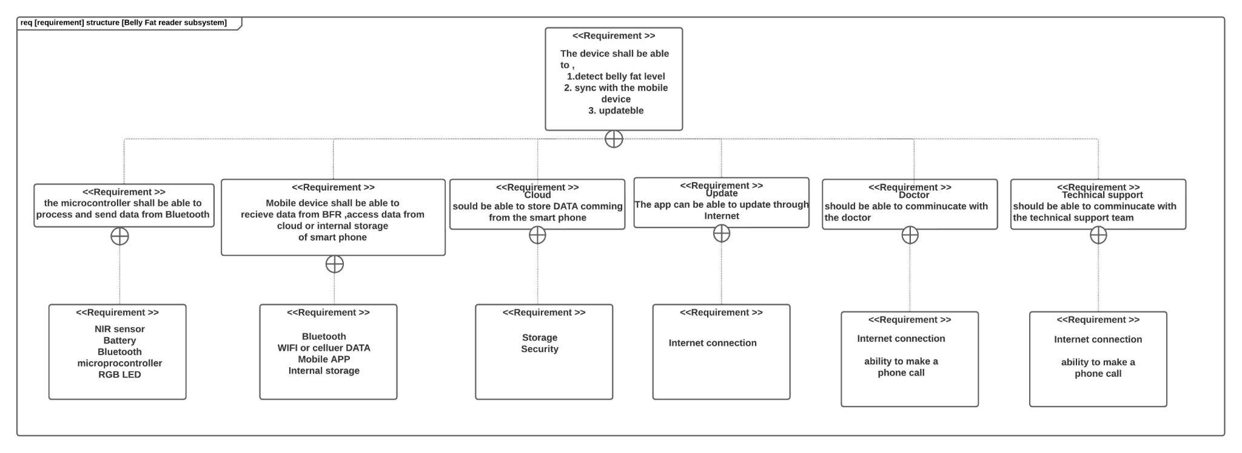
The Requirement Diagram
Fig: 21: the requirement diagram

Slide 12
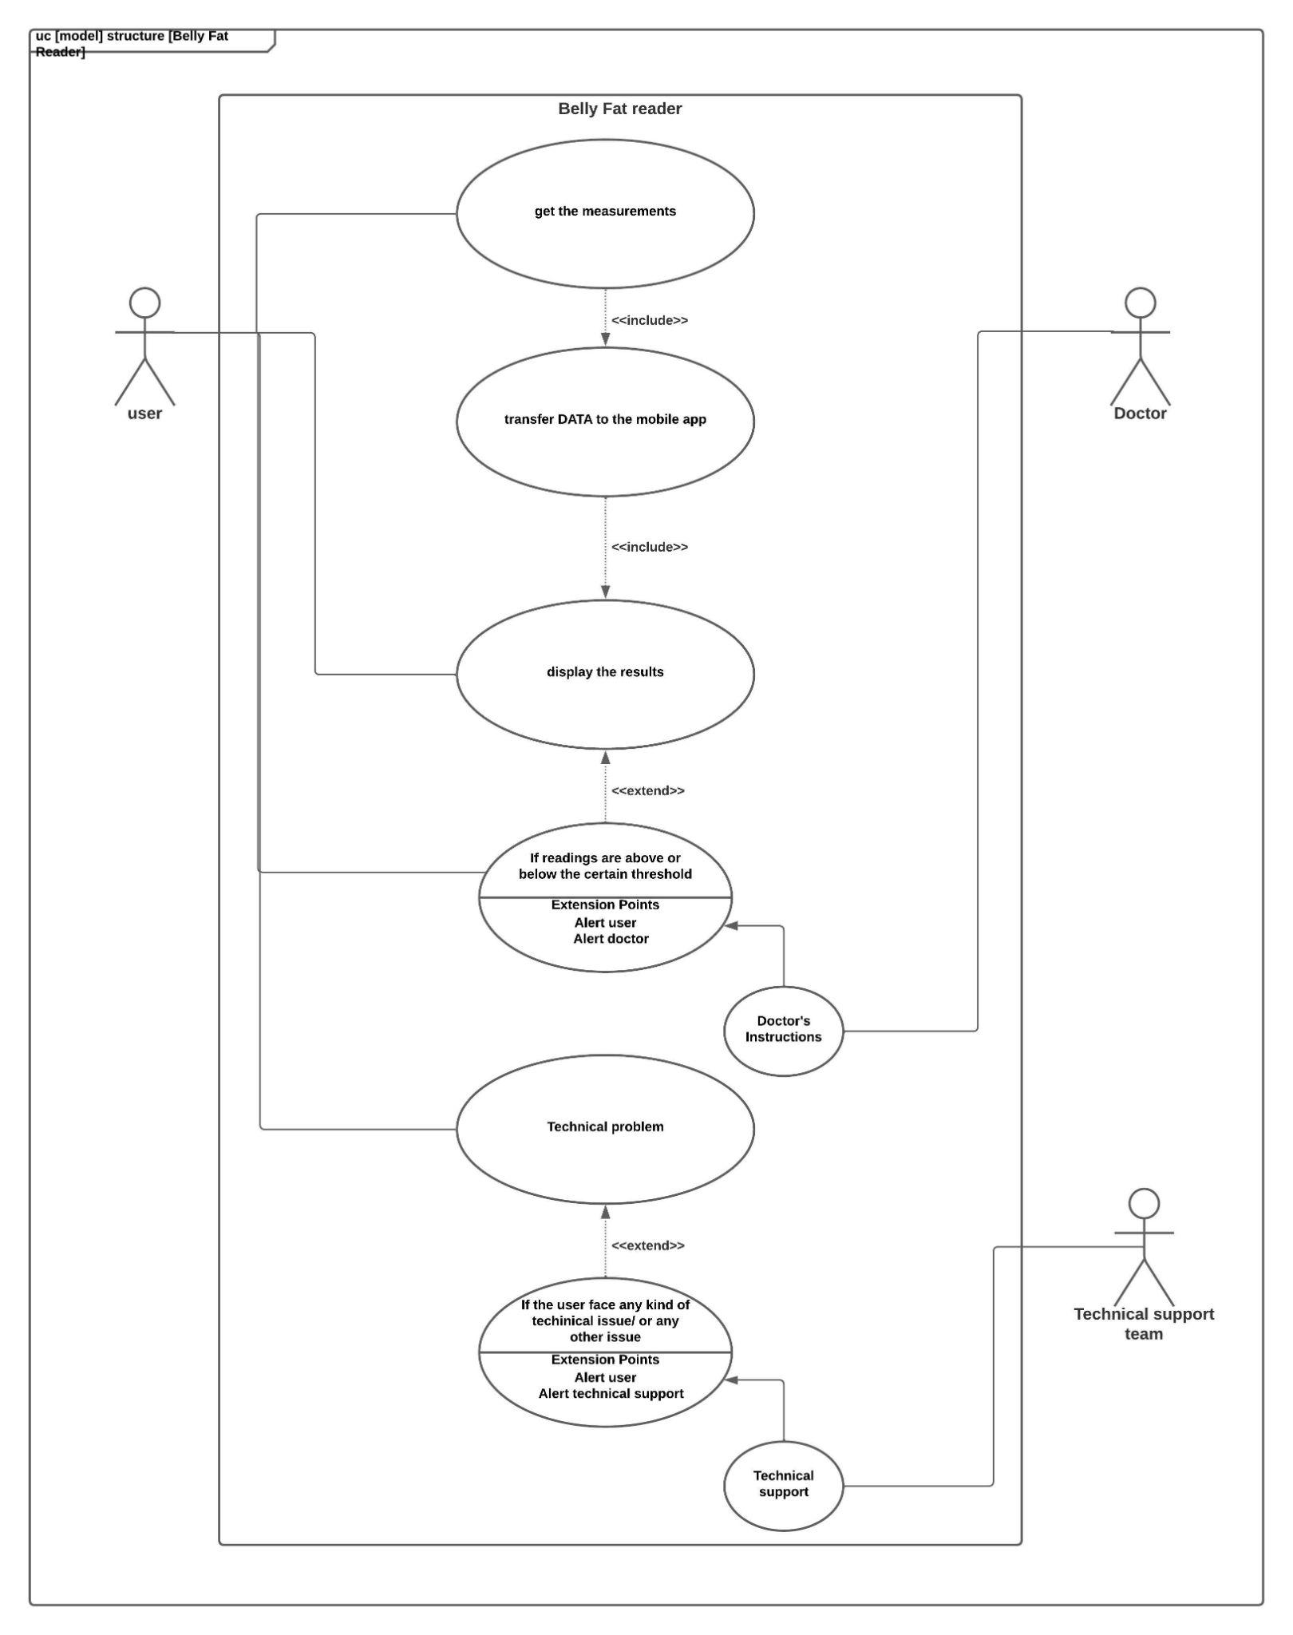
The Use Case Diagram
Fig: 22: the use case diagram

Slide 13
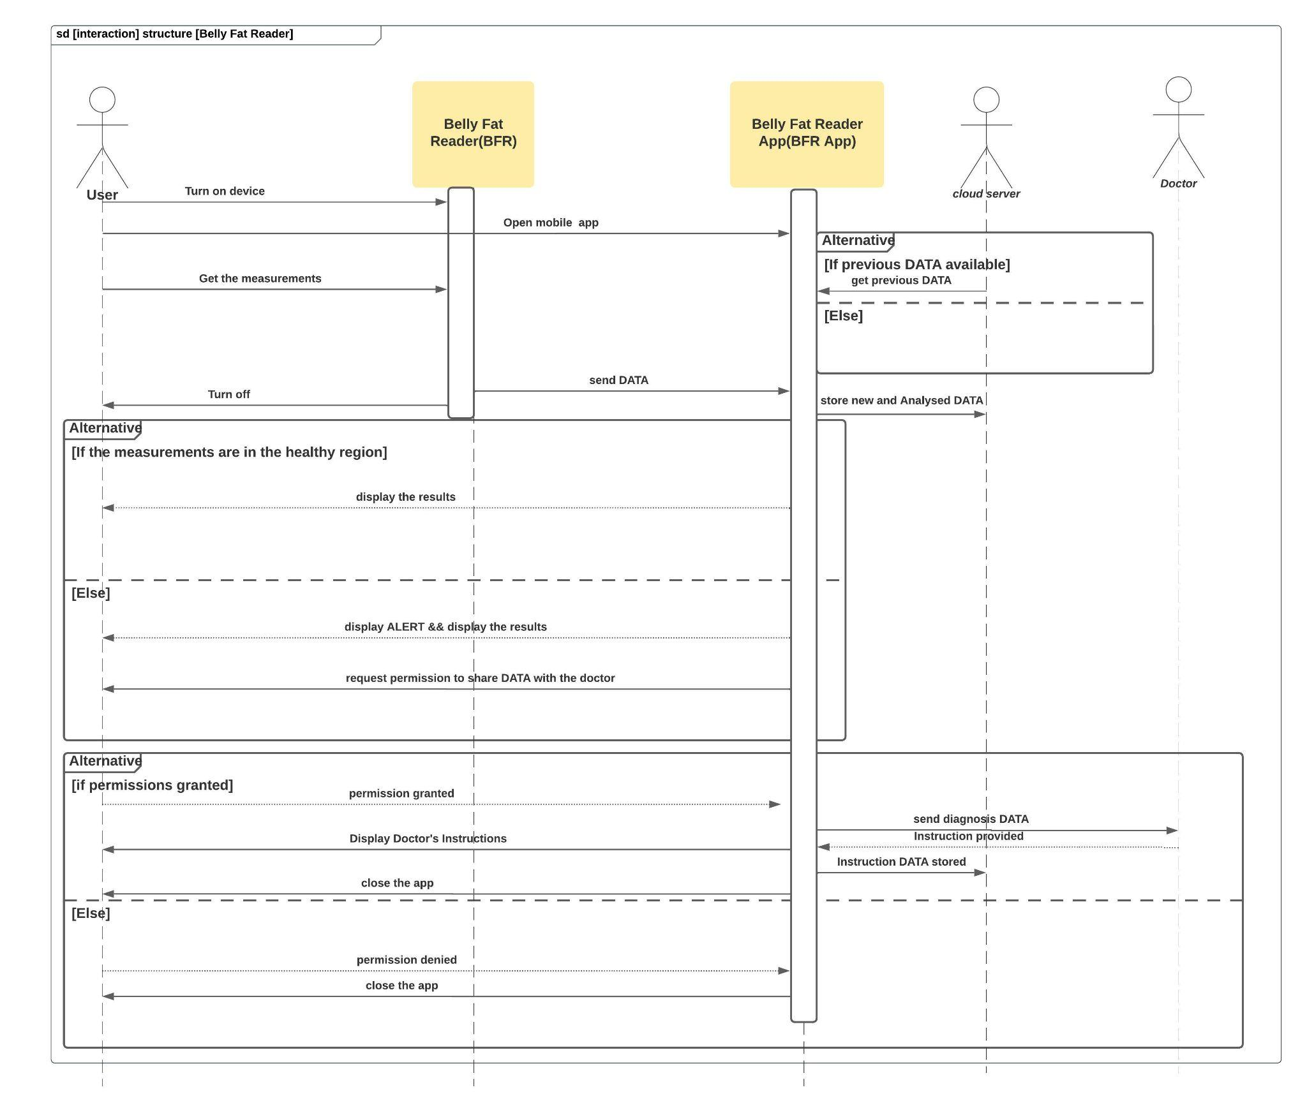
The Sequence Diagram
Fig: 23: The requirement diagram

Slide 14
Future directions
In the future upgrades, it is possible to add some functions like other lipid levels and H₂O , HbO₂
The components should be updated with better components in the future.
Make the app more user friendly

Slide 15
References
[1] “The theory of Near Infrared Spectroscopy”,artinis, 2020,
https://www.artinis.com/theory-of-nirs
[2] “The 10 Best Ways to Measure Your Body Fat Percentage”, Grant Tinsley, Healthline ,April 2018,
https://www.healthline.com/nutrition/ways-to-measure-body-fat#TOC_TITLE_HDR_2
Figure 01 and 08: SOLIDWORKS prototype model created by the author
Figure 02: Fast Foods https://businessfirstfamily.com/important-fast-food-industry-trends-to-investigate/
Figure 03: A person with high obesity
https://scitechdaily.com/obesity-might-be-a-result-of-your-bodys-chemistry/
Figure 04: Kind of fat in human belly
https://www.drkasenene.com/post/2019/02/26/have-you-heard-about-visceral-fat
Figure 05: drawn by the author
Figure 06: Near Infrared Interactance
https://www.measurement-toolkit.mrc.ac.uk/anthropometry/objective-methods/near-infrared-interactance
Figure 07: https://shop.olivehc.com/products/
Figure 08 to figure 15: drawn by the author
Figure 16: NIR Sensor
https://www.exp-tech.de/en/sensors/light/8347/spectral-sensor-breakout-as7263-nir-qwiic
Figure 17: Microcontroller; https://www.reichelt.com/de/en/development-boards-esp32-wi-fi-and-bluetooth-module-debo-jt-esp32-p219897.html?r=1
Figure 18: Battery; https://diyi0t.com/best-battery-for-esp8266/
Figure 19: RGB LED; https://create.arduino.cc/projecthub/lewiskell/common-anode-rgb-led-4a5ece
Figure 120: Push button; https://www.exp-tech.de/en/accessories/buttonsswitches/4342/mini-push-button-switch-x20
Figure 21: the requirement diagram; drawn by the author
Figure 22: the use case diagram; drawn by the author
Figure 23: The requirement diagram; drawn by the author

Slide 16
Thank you!

